Slide 1
Employee Management System

Slide 2
Presented By 1. Sheikh Jami Jashim 2. Md Tanvir Hassan Sayem 3. Md Shahab Uddin

Slide 3
TABLE OF CONTENTS
01
02
03
04
05
06
Preface
Introduction
Objectives
Key Features
System Architecture
Software Design and System Requirements
07
08
Security and Data Policy
Real-World Applications
09
10
Advantages and Limitations
Conclusion

Slide 4
Preface
Welcome to the Employee Management System! In today's dynamic business environment, managing employees effectively is crucial for the success and growth of any organization. With an ever-increasing workforce and complex organizational structures, manual management of employee-related tasks can be overwhelming and prone to errors.
The Employee Management System is a comprehensive and user-friendly solution designed to streamline and automate various aspects of employee management. It serves as a central hub for managing employee data, tracking attendance, processing payroll, and facilitating communication within the organization.

Slide 5
Introduction
The Employee Management System (EMS) is a software application that will be used to manage the employee data of a company. The system will allow users to enter, update, and delete employee data, as well as generate reports on employee performance and attendance.
1) Employee Management System (EMS)
2) Human Resources Information System (HRIS)
3)Onboarding
4) Offboarding
5)Time and Attendance
6}Performance Management
7)Leave Management 8)Employee Self-Service (ESS) and Manager Self-Service (MSS)

Slide 6
Objectives
Engagement and Satisfaction
Enhance employee engagement and satisfaction.
Implementation
Outline the main objectives of implementing the EMS in your organization
Productivity and Performance
Optimize workforce productivity and performance . Optimize workforce productivity and performance.
HR efficiency
Improve HR efficiency and reduce administrative burden.
Compliance
Ensure compliance with labor laws and regulations.

Slide 7
Key features
CHANNEL 1
Centralized Employee Database: Easily access and manage employee information, records, and history in one secure location.
CHANNEL 2
Performance Management: Tools to set goals, conduct evaluations, and provide feedback.
CHANNEL 3
Employee Self-Service: Empower employees to update personal information and view relevant HR data.
CHANNEL 4
Payroll and Benefits Management: Efficient salary processing and benefit administration.

Slide 8
System architecture
Waterfall approach was first SDLC Model to be used widely in Software Engineering to ensure success of the project. In "The Waterfall" approach, the whole process of software development is divided into separate phases. In this Waterfall model, typically, the outcome of one phase acts as the input for the next phase sequentially. The following illustration is a representation of the different phases of the Waterfall Model. The sequential phases in Waterfall model are −

Slide 9
System architecture
Requirement Gathering and analysis − All possible requirements of the system to be developed are captured in this phase and documented in a requirement specification document.
System Design − The requirement specifications from first phase are studied in this phase and the system design is prepared.
Implementation − With inputs from the system design, the system is first developed in small programs called units, which are integrated in the next phase. Each unit is developed and tested for its functionality, which is referred to as Unit Testing.
Integration and Testing − All the units developed in the implementation phase are integrated into a system after testing of each unit. Post integration the entire system is tested for any faults and failures
.
Deployment of system − Once the functional and non-functional testing is done; the product is deployed in the customer environment or released into the market.
Maintenance − There are some issues which come up in the client environment. To fix those issues, patches are released. Also to enhance the product some better versions are released. Maintenance is done to deliver these changes in the customer environment.
All these phases are cascaded to each other in which progress is seen as flowing steadily downwards (like a waterfall) through the phases. The next phase is started only after the defined set of goals are achieved for previous phase and it is signed off, so the name "Waterfall Model". In this model, phases do not overlap.

Slide 10
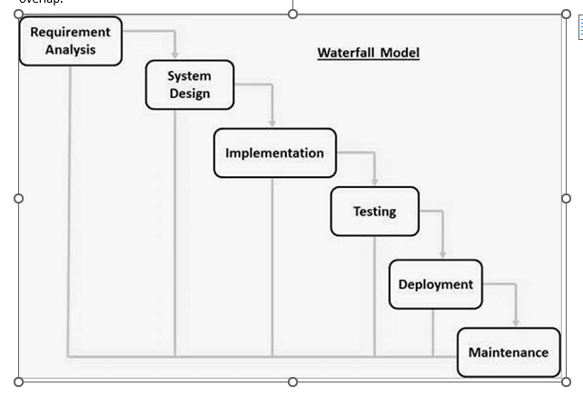

Slide 11
Software Design and System Requirements

Slide 12
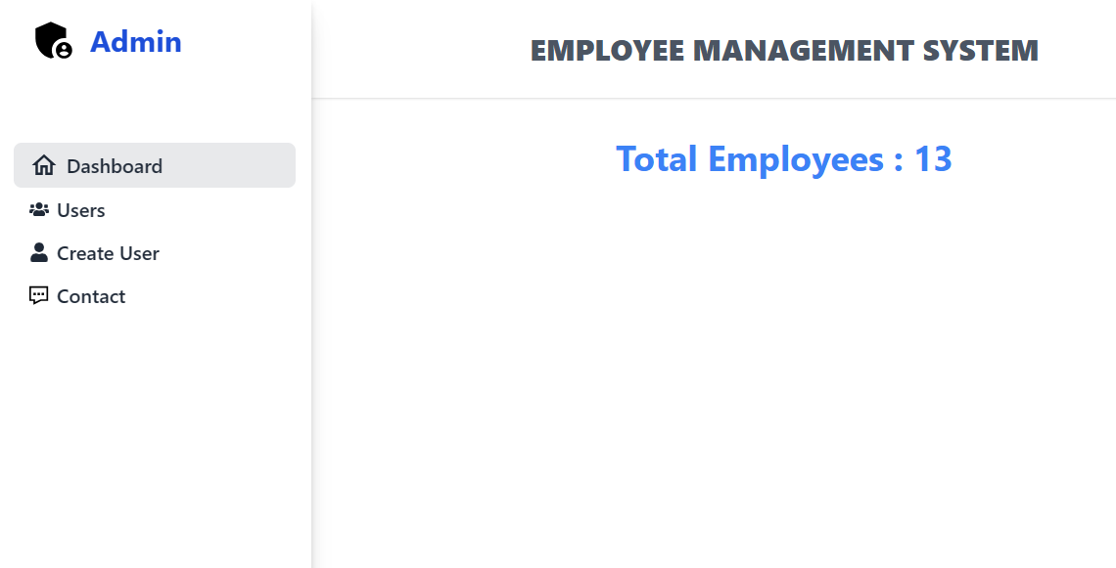
Admin Panel of the Employee Management System

Slide 13
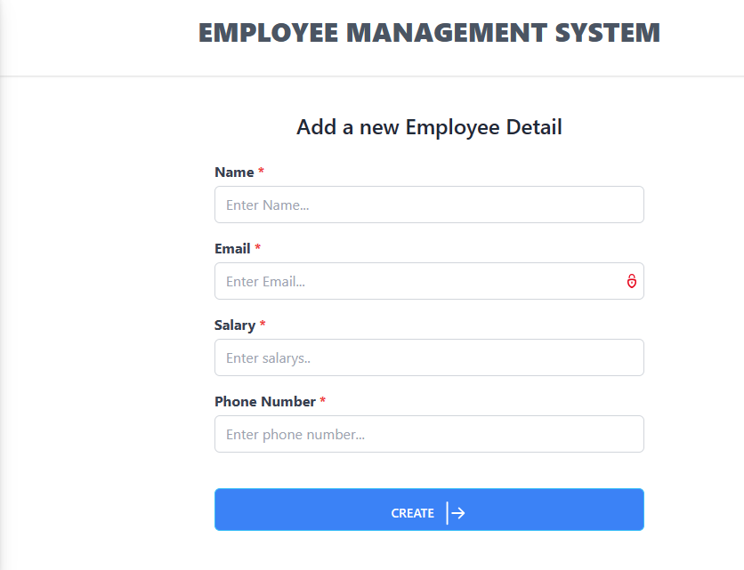
Adding a new Employee Detail

Slide 14
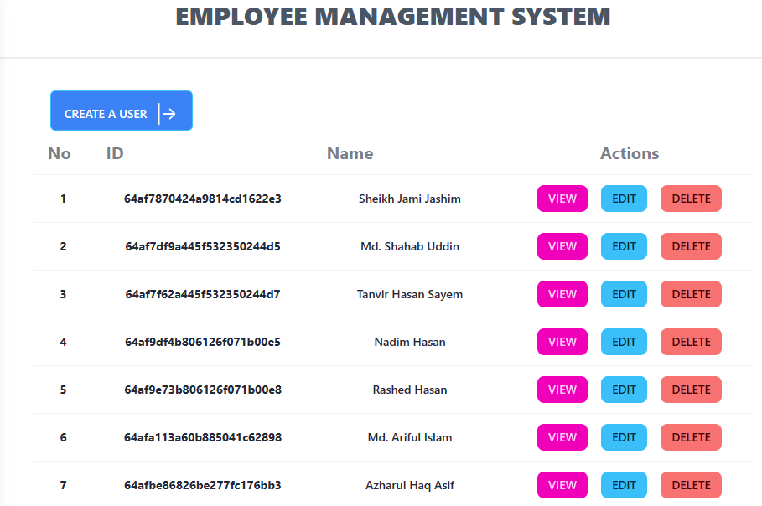
Employee Management

Slide 15
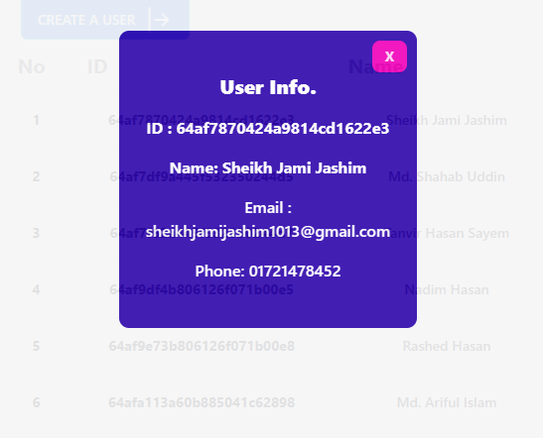
View Employee Details

Slide 16
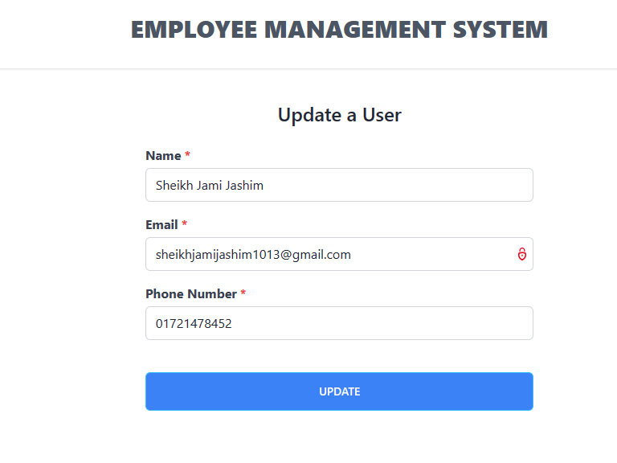
Update Employee Details

Slide 17
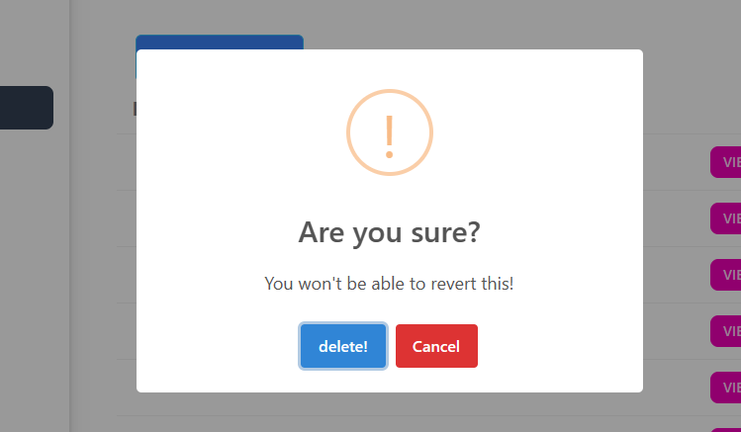
Delete Employee Details

Slide 18
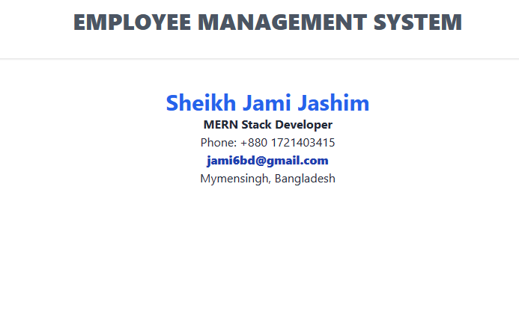
Contact Admin

Slide 19
Functional Requirement
Data entry
User Management
Data update
Employee Profiles
Data Delete
Leave and Absence Management

Slide 20
Non Functional Requirements
Security: The system must be secure and protect employee data from unauthorized access. Performance: The system must be able to handle a large number of users and transactions. Scalability: The system must be able to scale to meet the needs of a growing company. Usability Implementation Database, Web application, Programming language.

Slide 21
System Requirements
CPU: Core 2 Duo 1.8 GHz or better/ AMD Athlon 64 X2 3600+ or better
CPU SPEED: 2.4 GHz
RAM: 2 GB
VIDEO CARD: 128 MB DirectX 9.0c Video Card (NVIDIA GeForce 8600+ / ATI Radeon HD 2600+ / Intel HD 2000+)
DEDICATED VIDEO RAM: 128 MB
PIXEL SHADER: 3.0
VERTEX SHADER: 3.0
OS: Windows XP or better
FREE DISK SPACE: 5 GB

Slide 22
Security and Data Policy
Data Security
Encryption
Access Controls
Secure Authentication
Regular Auditing
Data Privacy
Consent
Anonymization/Pseudonymization
Data Retention Policies
Purpose Limitation
Data Backup and Disaster Recovery
Regular Backups
Disaster Recovery Plan

Slide 23
Real World Applications
Small Businesses
Streamline HR processes for small companies with limited resources.
Large Corporations
Efficiently manage complex HR needs in multinational organizations.
Industries
Suitable for various sectors, including IT, healthcare, finance, and manufacturing.

Slide 24
Advantages and Limitations
Advantages
Limitations
Efficiency
Centralized Data
Improved Communication
Enhanced Decision Making
Streamlined Recruitment
Employee Self-Service.
Cost
Learning Curve
Data Security Risks
Customization Challenges
Dependency on Technology
Integration Challenges

Slide 25
Conclusion The EMS will be a valuable tool for managing employee data. The system will be secure, scalable, and easy to use. The system will be implemented using Java and a relational database. The system will be tested using unit tests, integration tests, and system tests. The system will be deployed to a production environment once it has been successfully tested. The system will be maintained by a team of developers who will fix bugs and add new features as needed. The system will be documented using user manuals, API documentation, and change logs.

Slide 26
THANKS
@2023 All Rights Reserved

